Slide 1
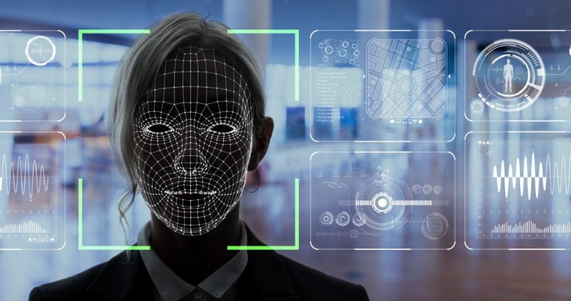
Facial Image Recognition using CRI-AI Thermal Cameras
Image Source: https://ngscinc.com/access-control-trends-for-2021-facial-recognition/

Slide 2
Content
Project Summary
Team Profile
Project Progress update
Individual Status Report
High-Level Timeline Chart (GANTT)
Plans for the next weekly status report

Slide 3
Project Summary
Purpose of this project is to develop a model a facial recognition system using CRI- AI Thermal cameras. CRI stands for Color Rendering Index and is nothing but a specification of cameras which states how accurately artificial light shows colors of the people under them.
Facial Recognition is the process of identifying a person through his or her facial features. We will be using thermal cameras to detect human faces. When we think about thermal images in the context of people, what usually comes to mind is night vision. The ability to see a person, or group of people, by the inevitable heat their bodies emit.
An important aspect of our project requires us to understand that thermal images capture heat in the form of frequency of pixels, varying from 0 to 1. Studies have found that each face emits a unique heat signature due to the blood vessels below the skin, as mentioned by Barclay (2013). Therefore, thermal facial images capture unique individual facial heat signatures which mark as unique biomarkers, providing us with rich information to classify a person correctly using a model.

Slide 4



Team Profile
Kishan Patel
(B.Sc. Physics, PGDCA, Big Data Solution Architecture)
A Big Data Analyst having non-cs bachelor degree, yet significantly interested, and competent in AI industry.
Tilak Pandya
(BCA, MCA)
A developer who explores concepts and potential in the tech industry.
Namrakumar Patel
(B.E. Computer Science)
A developer with real-world problem solving experience and a desire for innovation.

Slide 5
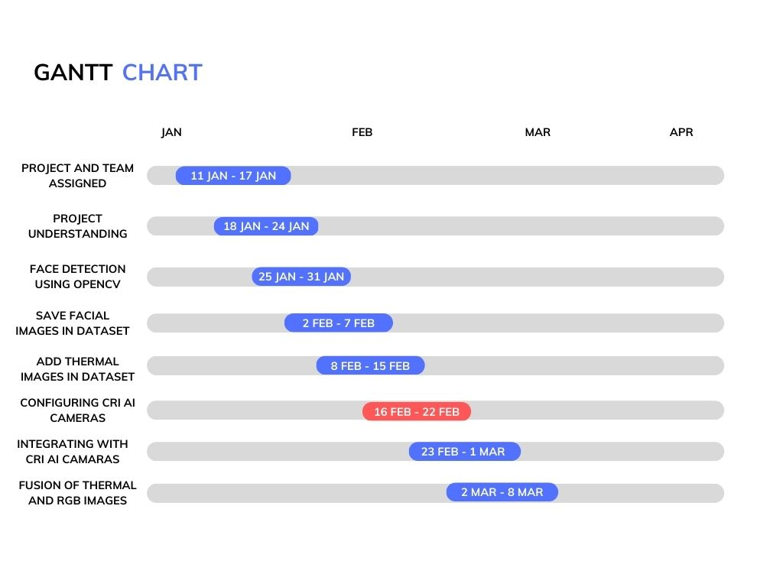
High-Level Timeline Chart (GANTT)

Slide 6
Project Progress Update
Face recognition using OpenCV LBPHFaceRecognizer_create model
Handled registration by storing in CSV
Configured iVMS 4200 camera
Troubleshooting of CRI AI Cameras and Black body radiation box
Update Git repository
Presentation.

Slide 7
Individual Status Report
Namra:
Handling Registration data using CSV
Storing pictures using registration ID
Fetching name from Identified face and printing name
Tilak:
Face Recognition
Checking CRI AI Camera configuration
Kishan:
Explored and identified the ways of connecting iVMS 4200 camera.
Troubleshooting Network and firewall settings for the camera.
Presentation

Slide 8
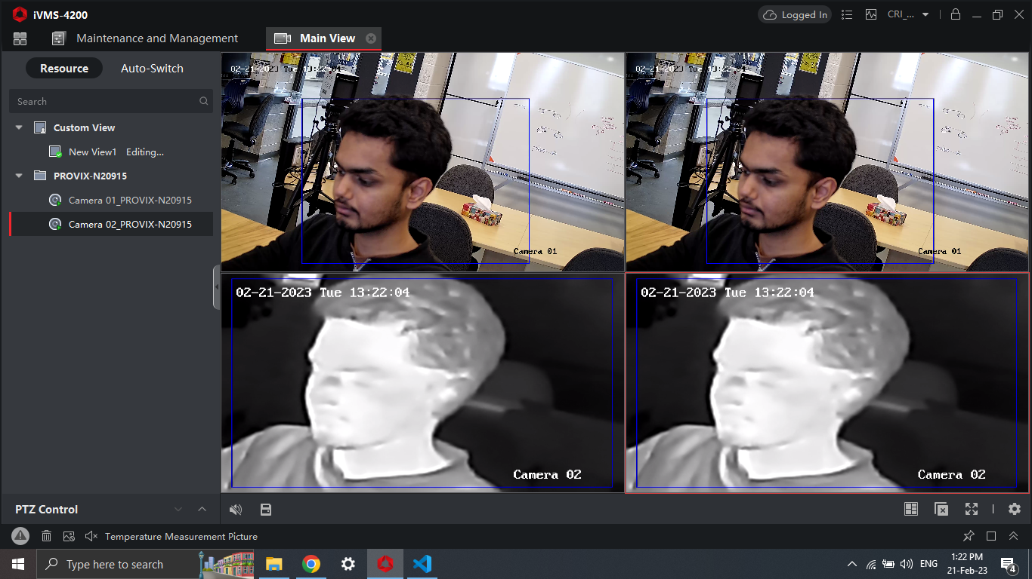
Accessibility to CRI AI Cameras

Slide 9
iVMS 4200 References
User manual of iVMS 4200: https://us.hikvision.com/en/system/files_force/ivms-4200_v2.8.2.2_windows_user_manual_v2_0.pdf?download=1
Software used: https://www.hikvision.com/ca-en/support/download/software/ivms4200-series/
For more information FAQs: https://us.hikvision.com/en/support-resources/documentation/faq/software

Slide 10
Now Onwards …
Integrating system and algorithms with CRI AI Camera.
Working upon connecting Black body radiation box to produce thermal images
Fusion of RGB and thermal images to produce accurate results

Slide 11
Hours worked

Slide 12
Thank you!

